Slide 1



E – COMMERCE SALES
A Python Project on E-commerce sales across India
View in Power BI
Under the guidance of
Ms. MANALI PATIL
Email: manalivikas.patil@anudip.org
Sincerely,
M. MOHAMMAD SOHAIL
BATCH CODE: ANP-C7333, STUDENT ID : AF0367070
Last data refresh:
4/10/2024 9:13:24 PM UTC
Downloaded at:
4/11/2024 3:50:03 AM UTC

Slide 2

CHAPTER 1: INTRODUCTION
Brief introduction to E-commerce sales
E-commerce sales refer to the buying and selling of goods and services over the internet, a rapidly growing sector driven by advancements in technology and changing consumer behaviors. This digital marketplace offers unparalleled convenience and choice, fueling its expansion globally as more businesses and consumers embrace online transactions.
Importance of E-commerce sales analysis:
Enhanced Decision Making
Improved Customer Insights
Increased Operational Efficiency

Slide 3
CHAPTER 2: PROJECT OVERVIEW
Planning and Requirements Definition
Development and Integration
Quality Assurance and Training
Project Overview:
This project analyzes e-commerce sales data to identify trends, optimize product offerings, and enhance customer satisfaction, leveraging statistical techniques and data visualization for actionable insights.
Brief overview of steps involved:
Objective of the project
Sales analysis boosts forecasting, inventory, promotions.
Analyze E-commerce sales data.
Analyzing E-commerce sales for trends, preferences, improvement.
Tools and technologies used:
Python Development
Data Analysis

Slide 4


CHAPTER 3: DATA COLLECTION
Source of data (e.g., sales database, CSV file)
The datasets for this project are collected from GitHub and Kaggle, primarily sourced from a sales database. CSV files supplement the data, containing relevant information like date, product details, quantity sold, and price, crucial for analysis and insights.
Explanation of data fields
Challenges: Data quality.
Concern: Data integrity.
Strategy: Mitigation and resolution.

Slide 5




.
CHAPTER 4: DATA PRE-PROCESSING
Data Understanding
Transformation/Engineering
Analysis/Insights
Data cleaning involves
Handling missing values.
Removing duplicates.
Formatting data types
Date string to date time.
Standardize: Data types.

Slide 6
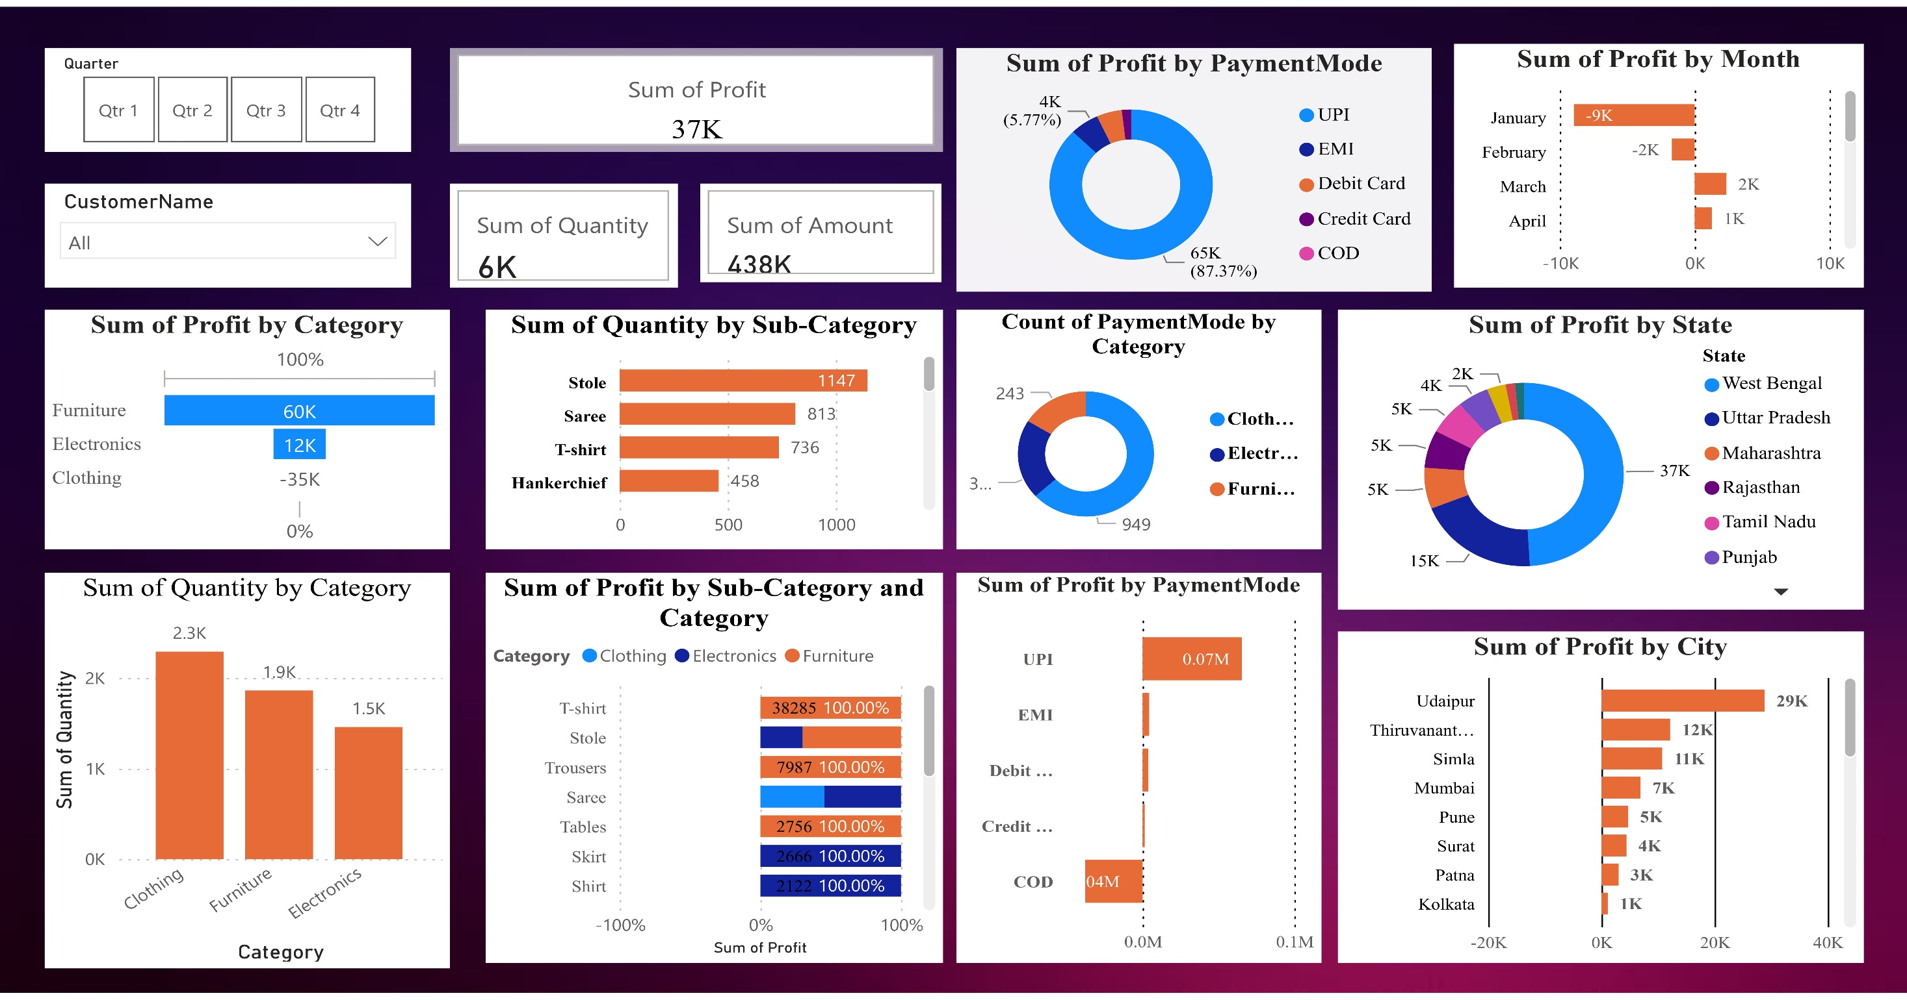
Page 1
CHAPTER 5: EXPLORATORY DATA ANALYSIS
Notes:
barChart
No alt text provided
barChart
No alt text provided
clusteredBarChart
No alt text provided
clusteredBarChart
No alt text provided
lineChart
No alt text provided
donutChart
No alt text provided
cardVisual
No alt text provided
donutChart
No alt text provided
clusteredBarChart
No alt text provided
slicer
No alt text provided
slicer
No alt text provided
clusteredBarChart
No alt text provided
donutChart
No alt text provided
hundredPercentStackedBarChart
No alt text provided

Slide 7

CHAPTER 6:
CUSTOMER SEGMENTATIONS
PROFITS
SUM OF PROFITS BY MONTH
SUM OF PROFITS BY STATE & CITY
QUARTERS
QUARTERS 1
QUARTERS 2
QUARTERS 3
QUARTERS 4
PAYMENT MODES
SUM OF PROFITS BY PAYMENT MODE
SUB-CATEGORY
SUM OF QUANTITY BY PAYMENT MODE
SUM OF PROFITS BY PAYMENT MODE
CATEGORY
SUM OF QUANTITY,PROFITS BY PAYMENT MODE

Slide 8
CHAPTER 7
SALES PREDICTION
MONTHS
STATE
CITY
HIGH
LOW
JANUARY
JANUARY (-9K)
WEST BENGAL (37 K)
NAGALAND (1093)
UDAIPHUR ( 29K )
AHEMABAD(19K)
PAYMENT MODE
CATEGORY
SUB - CATEGORY
HIGH
LOW
UPI (0.07 M)
COD (0.01M)
CLOTHING (949)
FURNITURE (243)
T-SHIRT (38285)
ACCESSORIES (-23-29)

Slide 9


CHAPTER 8: RECOMMENDATIONS
INVESTS
DISREGARD
CATEGORIES
CLOTHING
SUB CATEGORIES – T-SHIRT
STATE
WEST BENGAL
PAYMENT MODE- UPI
CATEGORIES
ELECTRONICS
SUB CATEGORIES - ACCESSORIES
STATE
GUJARATH
PAYMENT MODE- UPI

Slide 10

CHAPTER 9: CONCLUSION
Highest profit in October with $10k, west Bengal (udhaipur) with UPI in clothing.
LINK GitHub: https://github.com/S-ohai/E-COMMERCE-SALES-ANALYSIS

